Slide 1
AI based approaches to improve data quality before indexing
#haystackconf
2022-04-28 @lucianprecup
@search_with_all
@a2lean

Slide 2
[ adelean ]
Experts in Search Technologies
Integrators of Elasticsearch and Solr
Consulting, Services and Training providers
Developers of a2 – your Search Engine Technology for E-Commerce and Enterprise Search

Slide 3
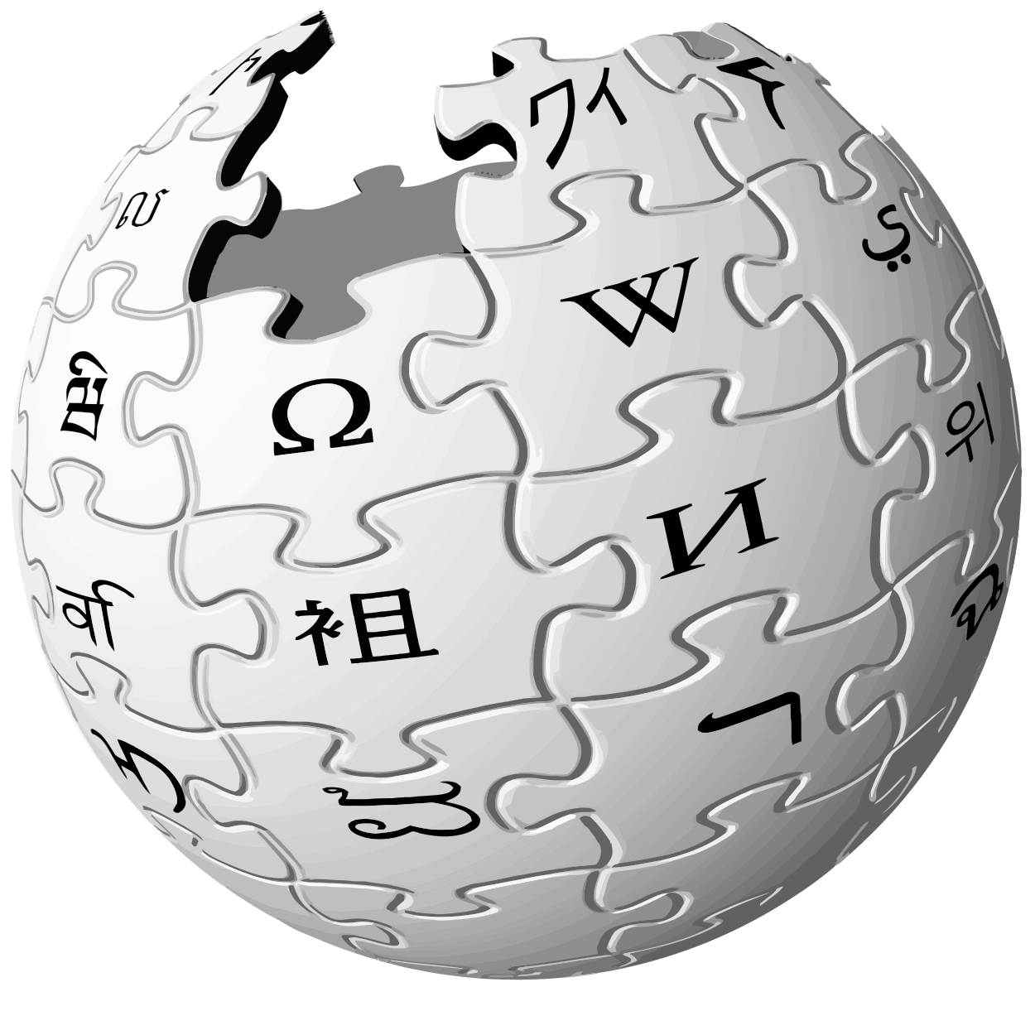
[ all.site ]
Wikipedia and Wikidata - knowledge databases → powered by the community
Github - code and coders’ social network → powered by the community
Reddit - the front page of the Internet → powered by the community
all.site - your collaborative search engine → powered by the community

Slide 4
Quiz - How many of you:
Use AI in your search projects ?
Use something that can be called AI in your search engines ?
Remember ETL ?
Know what ETL is ?
Implemented a Data Quality Solution in the context of Business Intelligence ?
Spend more than half of your time in getting data into the search engine ?

Slide 5
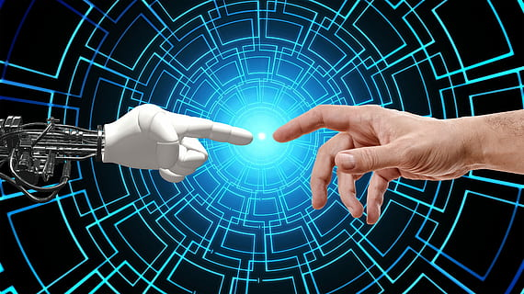
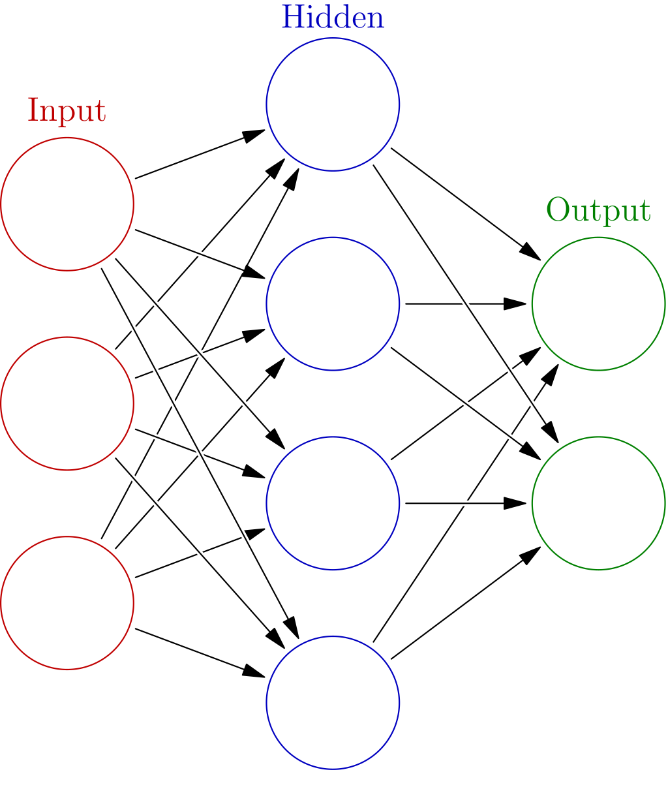
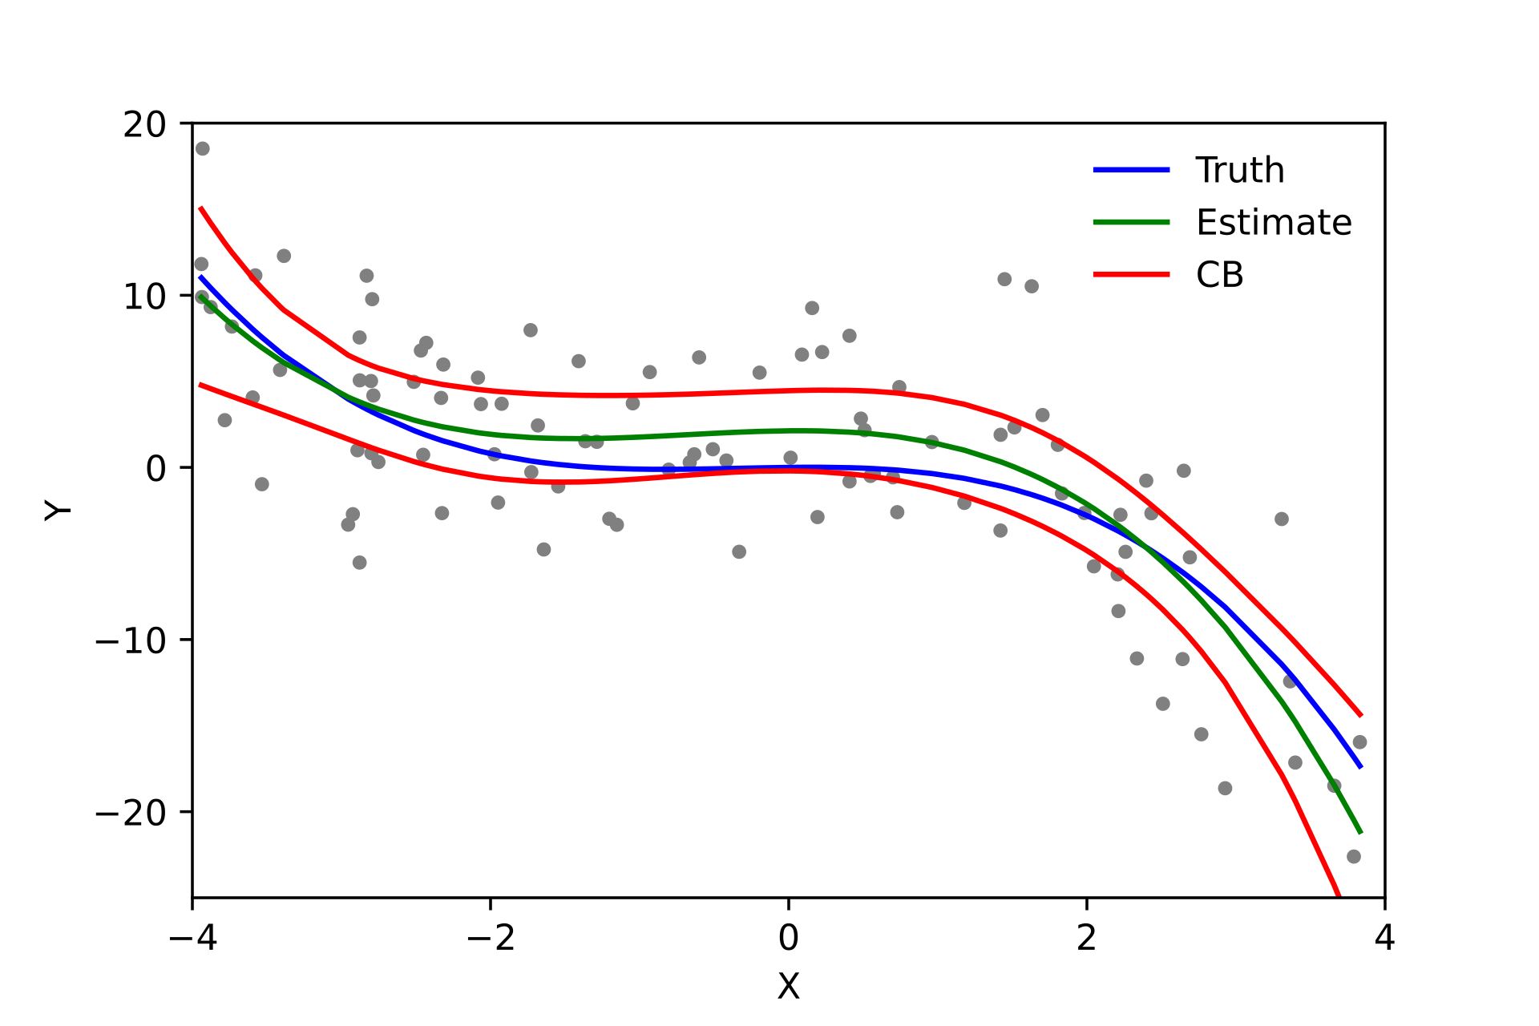
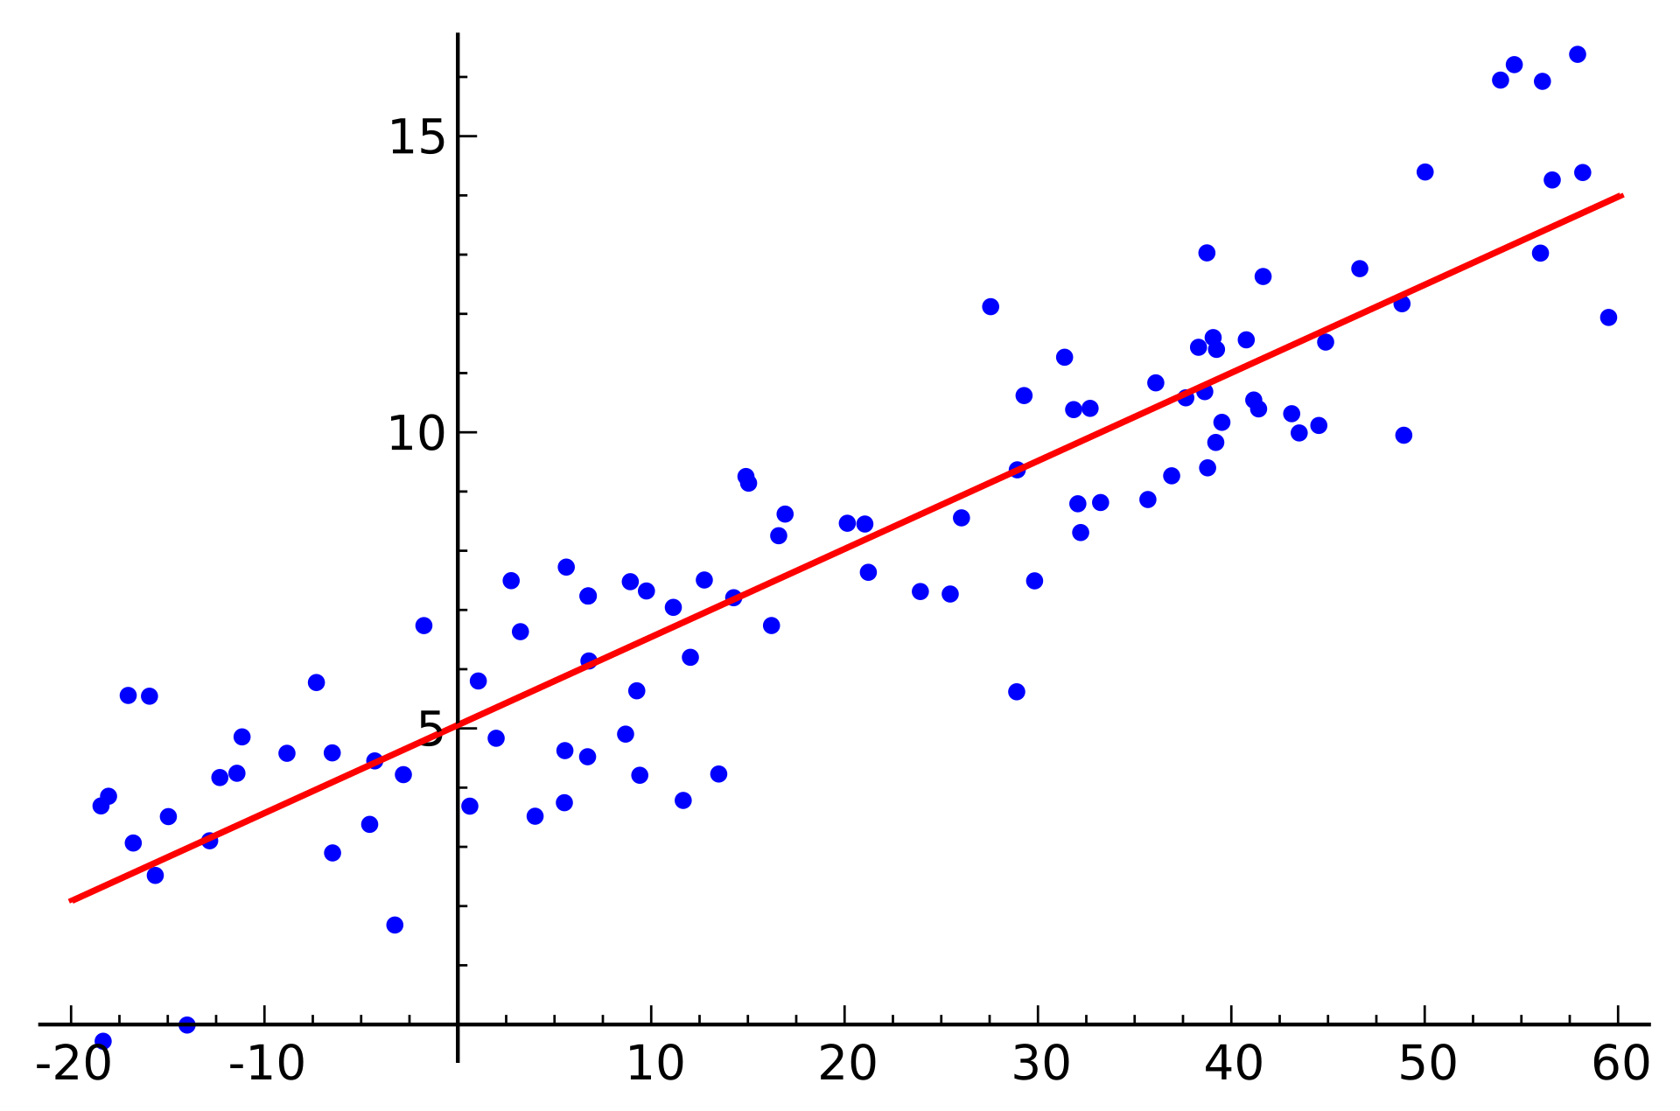
AI?
AI
//
Machine Learning
//
Regression
//
Linear regression
//
If … then … else

Slide 6
Why not AI at search time ?

Slide 7
How search engines work
Crawling
Indexing
Ranking
examine the content they have permission to see
categorize each piece of content
decide which content is more useful to the searchers
“The goal of the search engine remains the same : trying to connect the searcher to what they are looking for”

Slide 8
The secret sauce
“The way search engines rank content is top secret” -- Google Digital Garage
https://youtu.be/3CgJRdJetiw?t=210
Crawling
Indexing
Ranking
examine the content they have permission to see
categorize each piece of content
decide which content is more useful to the searchers
“There’s a bit of a buzzword salad in the industry these days” -- Trey Grainger
https://youtu.be/w5f4mJHOfrA?t=48

Slide 9
Learning to Rank in E-Commerce
Fine grained relevance tuning
Boosts
Function scores
Synonyms
Redirections
Query rewriting
User experience
Conclusion :
Takes into account Business needs (marketing, stock, partnerships, …)
Easily understandable and maintainable by the Business
Learning to Rank (automated relevance tuning)
Ranking model
Learning algorithm
Training data
Conclusion :
Very expensive to implement properly
Needs a lot of maintenance
Does worse if not properly trained and maintained
Black box to the Business
VS.

Slide 10
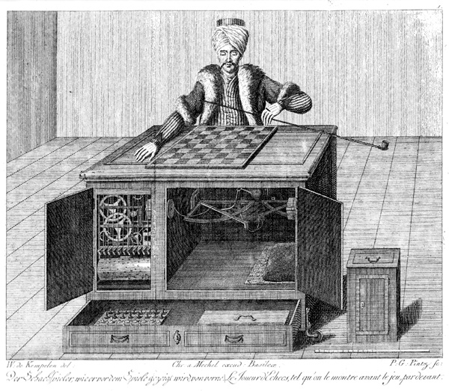
The best AI :-)

Slide 11
How about the others ?
Google’s BERT (Bidirectional Encoder Representations from Transformers)
BERT helps “only” one in ten searches https://blog.google/products/search/search-language-understanding-bert/
Algolia’s AI
Besides NLP / NLU, it resumes to Dynamic Synonyms, Personalization and … BYO AI (Bring your Own AI) https://www.algolia.com/blog/ai/launching-an-industry-leading-artificially-intelligent-search-platform/

Slide 12
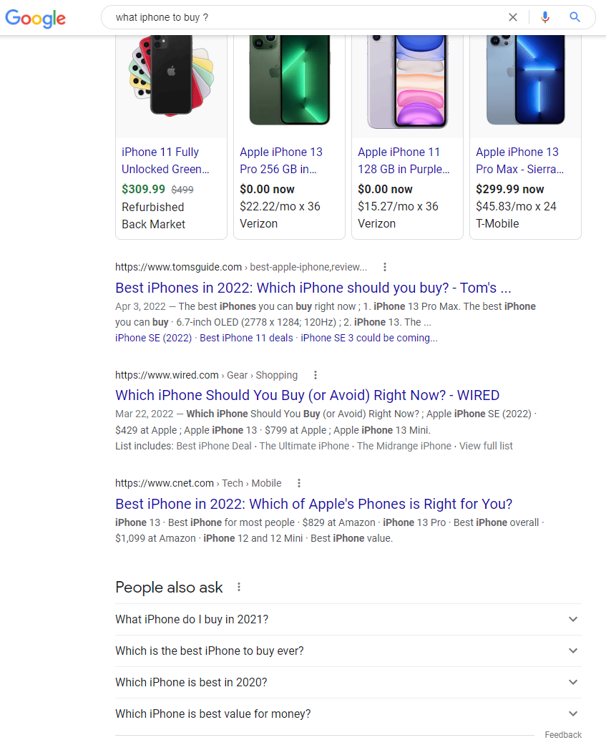
Questions → query understanding: “only” one in ten searches
https://www.google.com/search?q=what+iphone+to+buy+%3F

Slide 13
Where does AI fit best?
Crawling
Indexing
Ranking
Automatic document classification
Content clustering
Dynamic synonym suggestion
Data cleaning (OCR, noise reduction)
NLP / NLU / Question answering
Searching for unstructured data
examine the content they have permission to see
categorize each piece of content
decide which content is more useful to the searchers

Slide 14
Why improve data quality before indexing ?

Slide 15
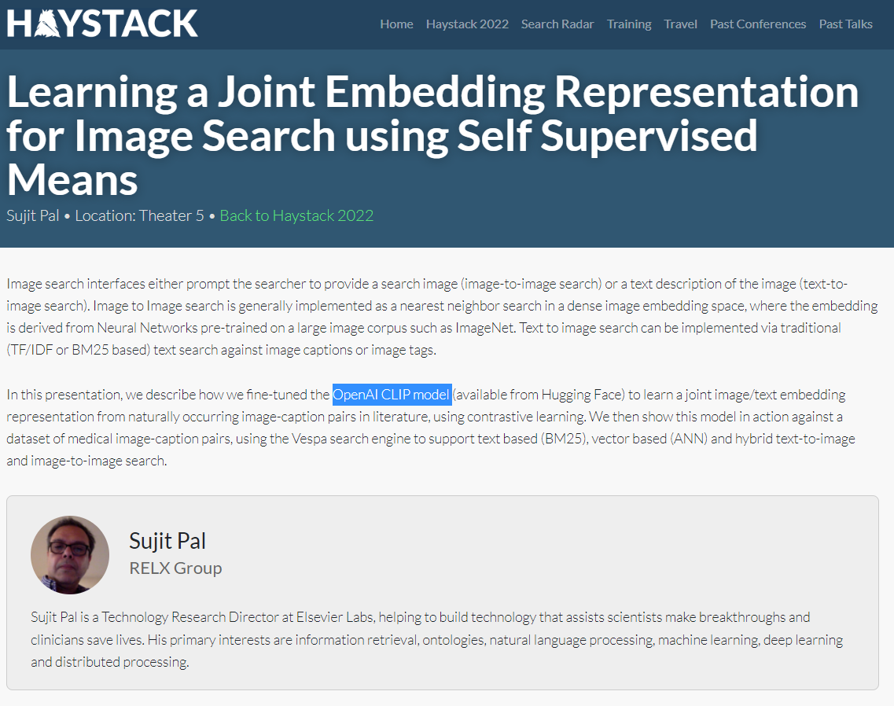
Image Search
https://haystackconf.com/us2022/talk-1/

Slide 16
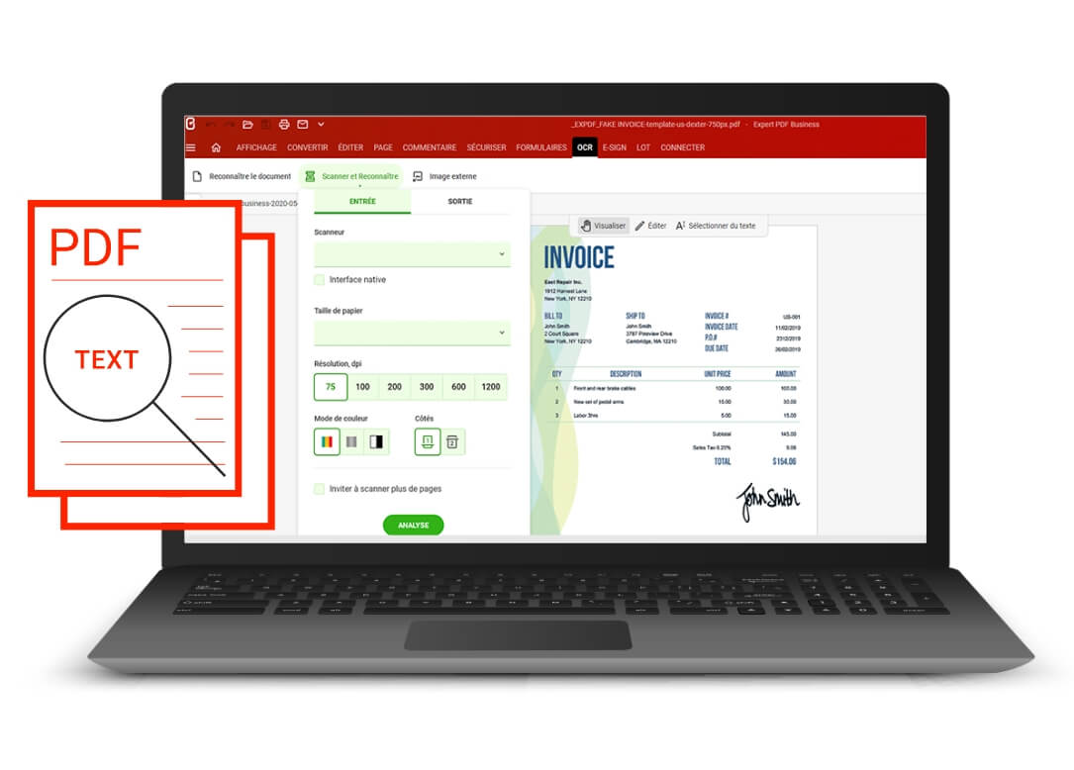
Text in media files
The current search engines are very good at text
We have OCR for images
More and more video and audio content

Slide 17
Why improve data quality before indexing ?
Some data is simply not searchable without proper enrichment (eg. images, media).
AI-based matching and ranking is not ready for all challenges, dense vector retrieval is hard
Good old inverted index still competitive when it comes to scale horizontally to billions of candidate documents.
Maximizes the possibilities of analytics (not only information retrieval from the index)

Slide 18
Extract Transform … Search?

Slide 19
Data consumption in Business Intelligence

Slide 20
Domain of a search engine
Adelean a2
Crawl Ingest
Transform
Aggregate
Index
Search Services
UI
Connectors and Integrations
Elasticsearch
Business Console

Slide 21
A search project
Crawl Ingest
Transform
Aggregate
Index
Search Services
UI
Connectors and Integrations
Core search
Business Console
Getting and preparing the data :
60% of a search project
From ETL to Extract Transform Search

Slide 22
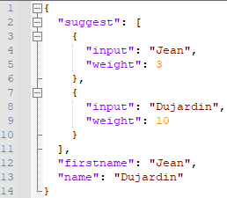
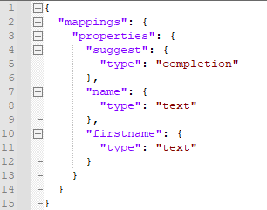
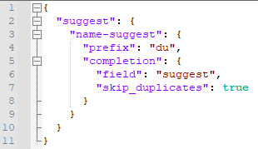
[Completion suggester]
Document
Mapping
Query

Slide 23
Maximizes the possibilities of analytics
Find
Inspire

Slide 24
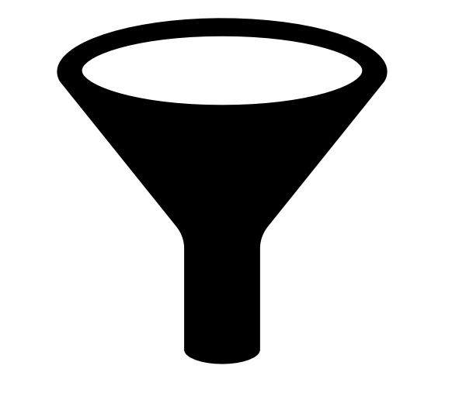
Maximizes the possibilities of analytics
Refine
Overview

Slide 25
How to improve data quality for search ?

Slide 26
How to improve data quality for search ?
Improve text quantity (OCR from image, Speech to text from media/video, …) + prevent excessive quantity with automatic summarization, ...
Improve text quality (vocabulary, sentences, punctuations, ...)
Make data homogeneous (spelling, synonyms, acronyms, …)
Add structure (metadata)
Add linguistics (language detection, translations)
Add semantics (Named Entity Recognition, categorization...)
Organize semantics (think knowledge graphs or ontologies, as in wikidata)

Slide 27
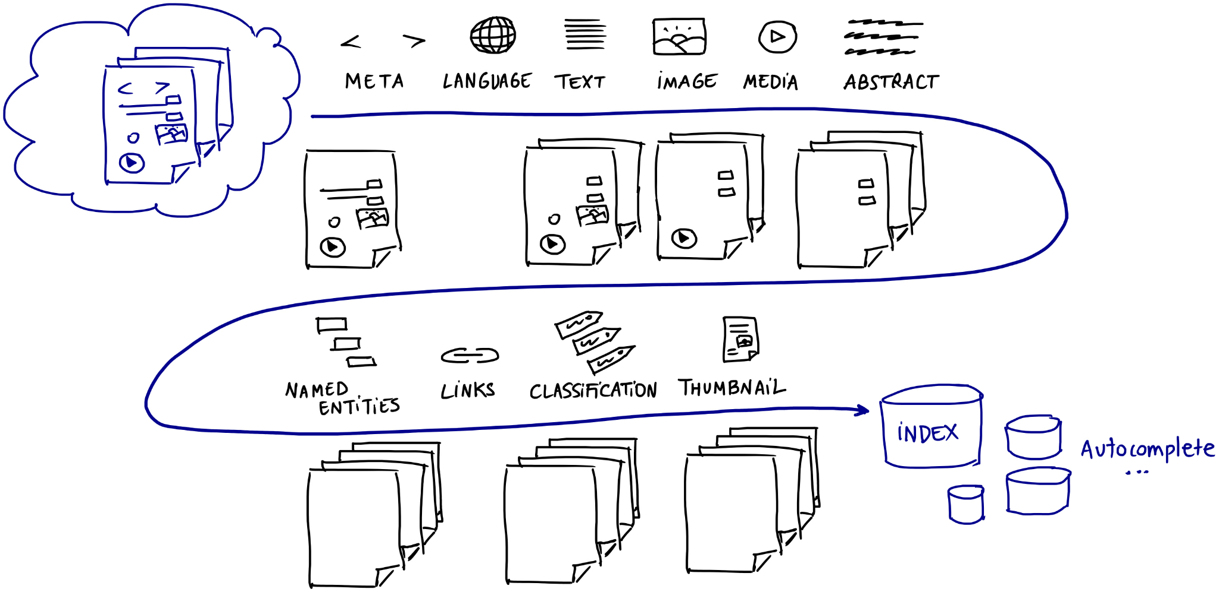
The road from data sources to index

Slide 28
Categorization
With or without AI
https://2021.berlinbuzzwords.de/session/text-categorization-apache-lucene

Slide 29
A2 Common Schema
"json" : {
"a2type" : "media"
},
"attachment" : {
"content" : "[...]"
},
"geopoints" : [ ],
"entities" : [ ],
"source" : {
"uri" : "http://...",
"type" : "crawler",
"name" : "WEB-6203a308b38fab2fc66693f2",
"lastModified" : -1,
"documentName" : "backend.mp3"
},
"metadata" : {
"fullPath" : "/",
"fileName" : "backend.mp3",
"fileExtension" : "mp3",
"userFriendlyPath" : "/",
"domainName" : "171.20.10.5:9000",
"rootPath" : "/"
},
"language" : "fr-FR",
"hash" : "334e6600741bdbcdca83eef9a8ed99558be5c084"

Slide 30
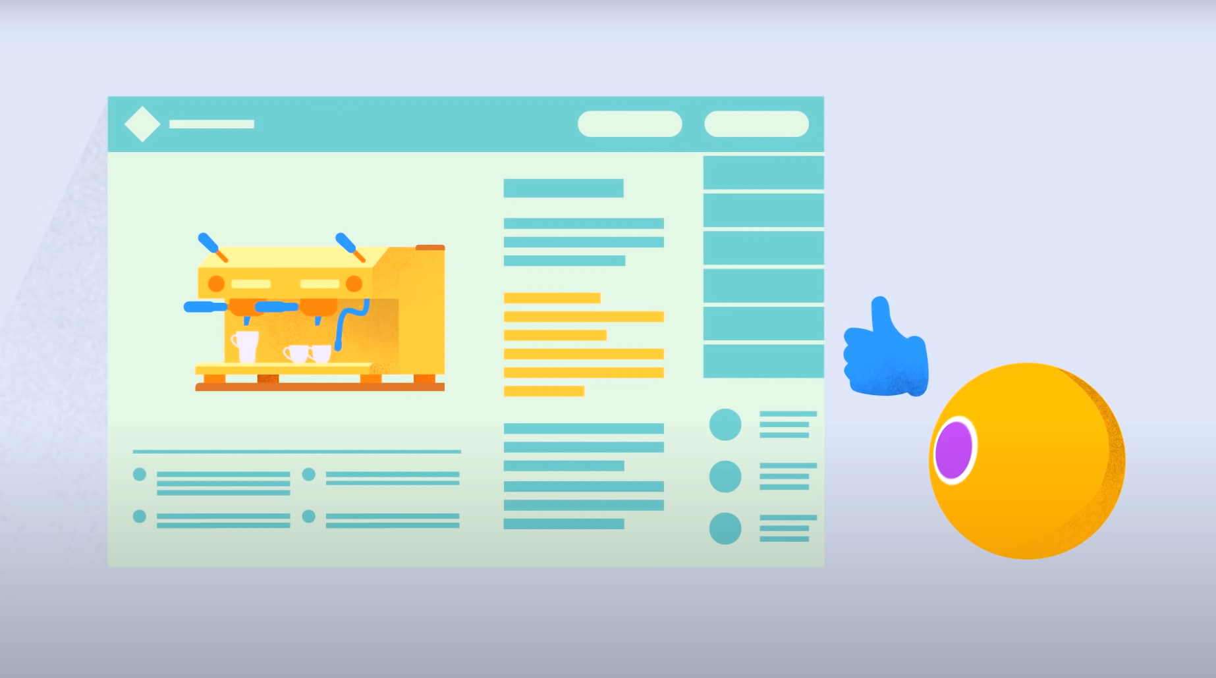
Deduplicating content
Google : “Do not copy the content !”
Google Digital Garage - How search engines work : https://www.youtube.com/watch?v=3CgJRdJetiw&t=115s

Slide 31
How to deduplicate?
Field collapsing vs. Update API

Slide 32
[ Elasticsearch field collapsing ]
GET /all-documents/_search
{
"query": { "match": { "attachment.content": "elasticsearch" } },
"collapse": {
"field": "hash",
"inner_hits": [
{
"name": "locations",
"size": 10,
"sort": [
{ "popularity": { "order": "desc" } }
]
}
]
}
}
https://github.com/adelean/elasticsearch-cheatsheet/blob/master/elasticsearch-cheatsheet.md#explore-data-grouped-by-a-field

Slide 33
What AI/ML does well
Identifying language
Identifying named entities
Identifying phrases or expressions
Identifying similarities (allowing for automatic synonym detection)
Translating text
Summarizing text

Slide 34
Data augmentation to improve text classification
Synonym replacement
Synonyms can be fetched from knowledge graphs such as WordNet, or simply using transformers and pretrained models
I went to see a movie in the theater -> I went to watch a movie in the theater
Enriching sentences
Inserting words into sentences. The word could be generated using context aware transformers such as BERT or any word embedding algorithm (word2vec).
I work in Paris -> I work in capital Paris

Slide 35
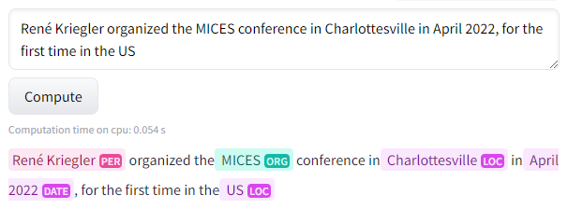
NER (Named Entities Recognition)
Categorizing text into entities. Paragraphs = a collection of entities
This lets the search engine classify topics in a page and determine their relationship with other text
Example of entities: Person, Region, Organization
https://huggingface.co/Jean-Baptiste/camembert-ner-with-dates?text=Ren%C3%A9+Kriegler+organized+the+MICES+conference+in+Charlottesville+in+April+2022%2C+for+the+first+time+in+the+US

Slide 36
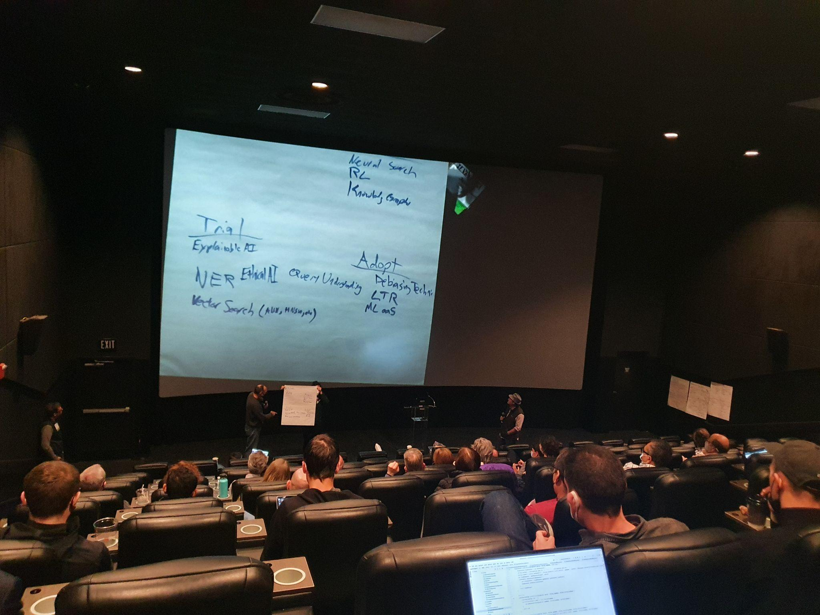
NER
https://haystackconf.com/radar/

Slide 37
Enrichment with user signals
Additional fields like
group_of_user (group of users potentially interested by the document),
user (user potentially interested by the document),
similar_documents (for recommandations).
Boost the most popular queries by indexing them with documents
[ Solr ] DelimitedPayloadBoostFilter
"signals_boosts": "ipad|2939,ipad 2|1104,ipad2|540,i pad|341,apple ipad|152"

Slide 38
[ Elasticsearch ] Inference processor
Use ML in ingest pipelines to enrich documents before indexing
https://www.elastic.co/guide/en/elasticsearch/reference/8.1/inference-processor.html

Slide 39
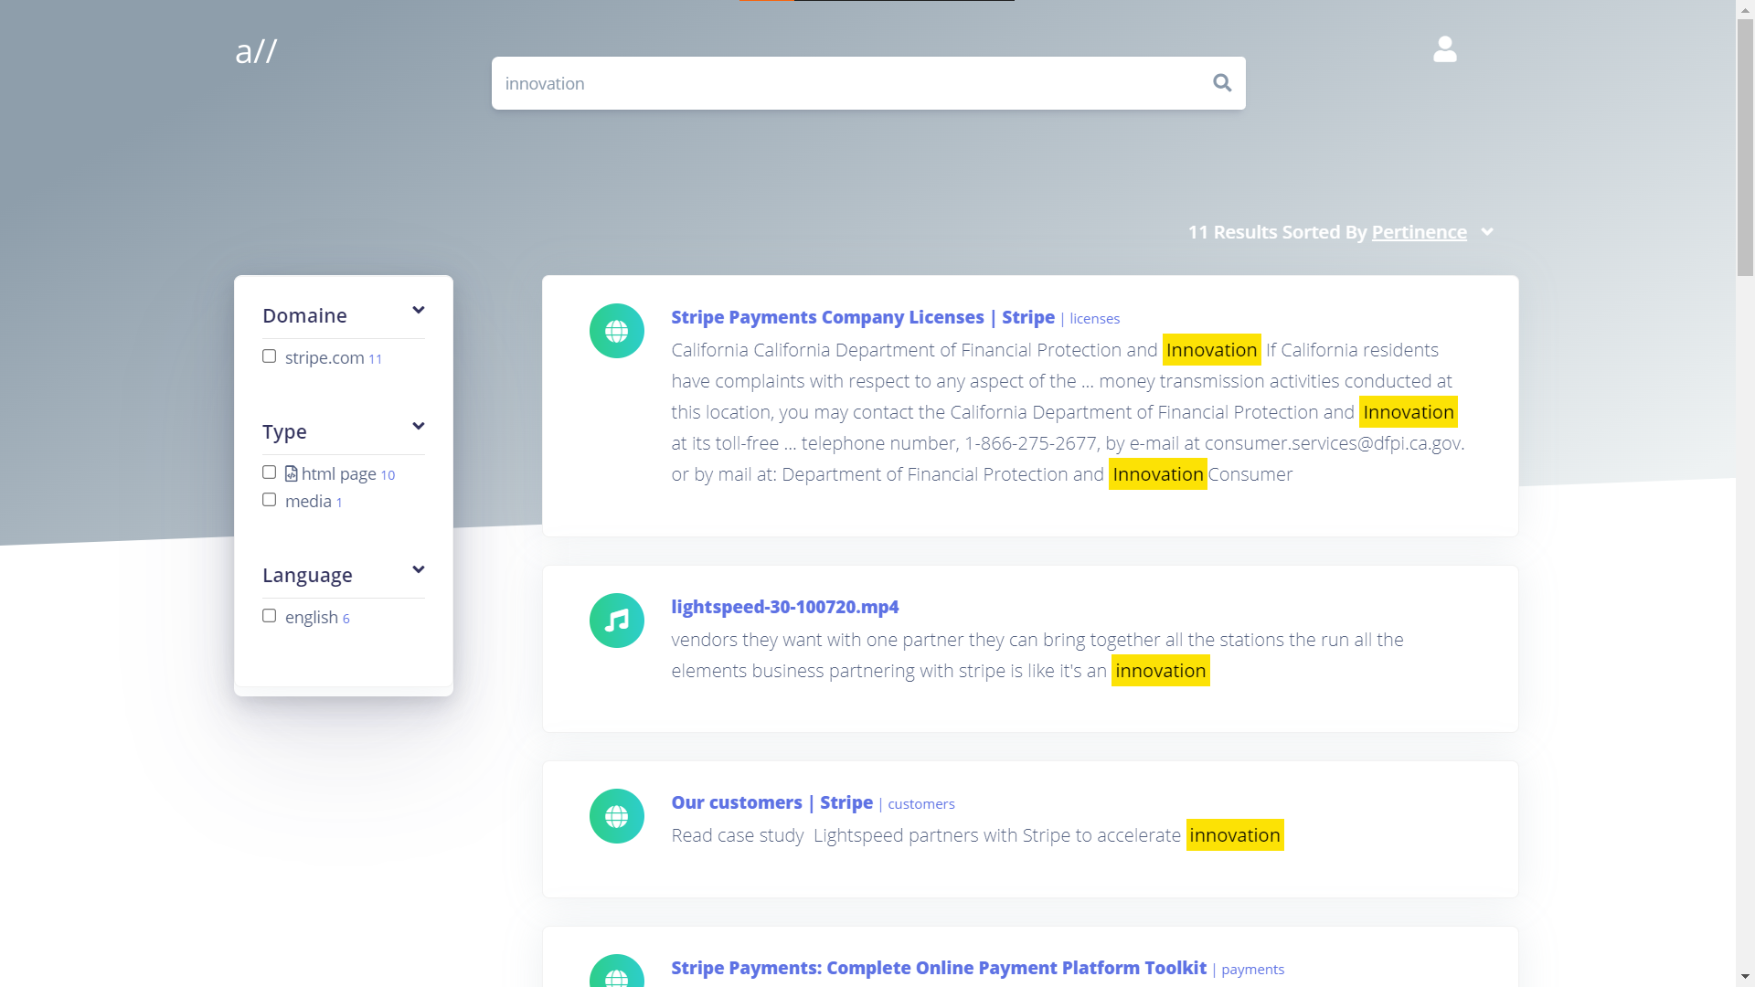
Vosk API - extracting text from media files

Slide 40
https://2021.berlinbuzzwords.de/ session/speech-text-elasticsearch

Slide 41
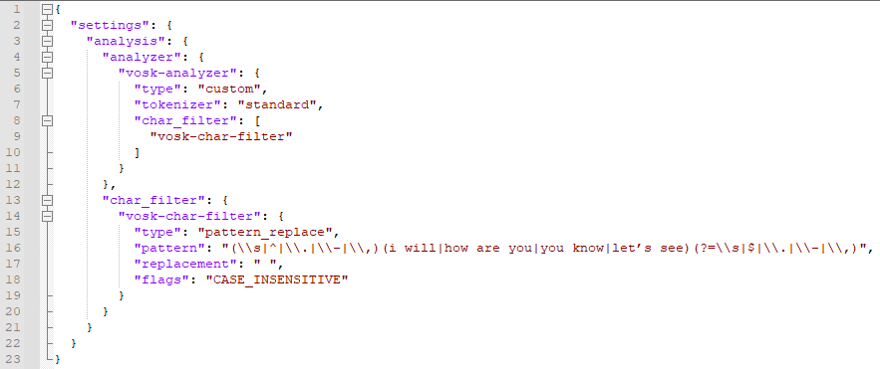
Specific optimizations
Spoken language vs. written language

Slide 42
Thank you for your attention
Questions / Feedback / More …
@lucianprecup
@search_with_all
@a2lean
info@adelean.com
http://all.site
http://www.adelean.com
http://www.linkedin.com/company/adelean
http://www.meetup.com/fr-FR/search-and-data

